Slide 1
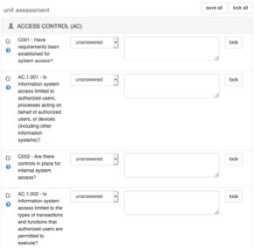
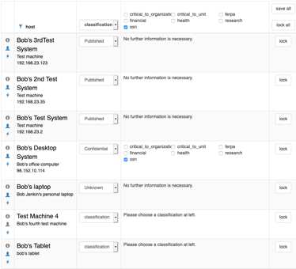
Assessment: Campus-wide Risk
Assessment Type: Annual Departmental Risk Assessment
Due date: May 30, 2020
Target Type: Classification
OUs to assess:
HR, ISO, ACC
Question List:
OU Annual
Are passwords required to be changed frequently (every 90 days or less)?
yes – 1.00
answer choices:
text + multiplier
yes but more than 90 days - 0.50
no – 0.00
weight- high
category: User-level Security
Response group:
yes-favorable-partial90-no
Question
OUs included
+
Question List
Unit Question Surveys
Host Categorization Surveys
1 set of surveys per OU
ISORA inventory data

